Slide 1



Youth engagement
View in Power BI
Last data refresh:
08/12/2022 17:56:17 UTC
Downloaded at:
08/12/2022 18:12:33 UTC

Slide 2
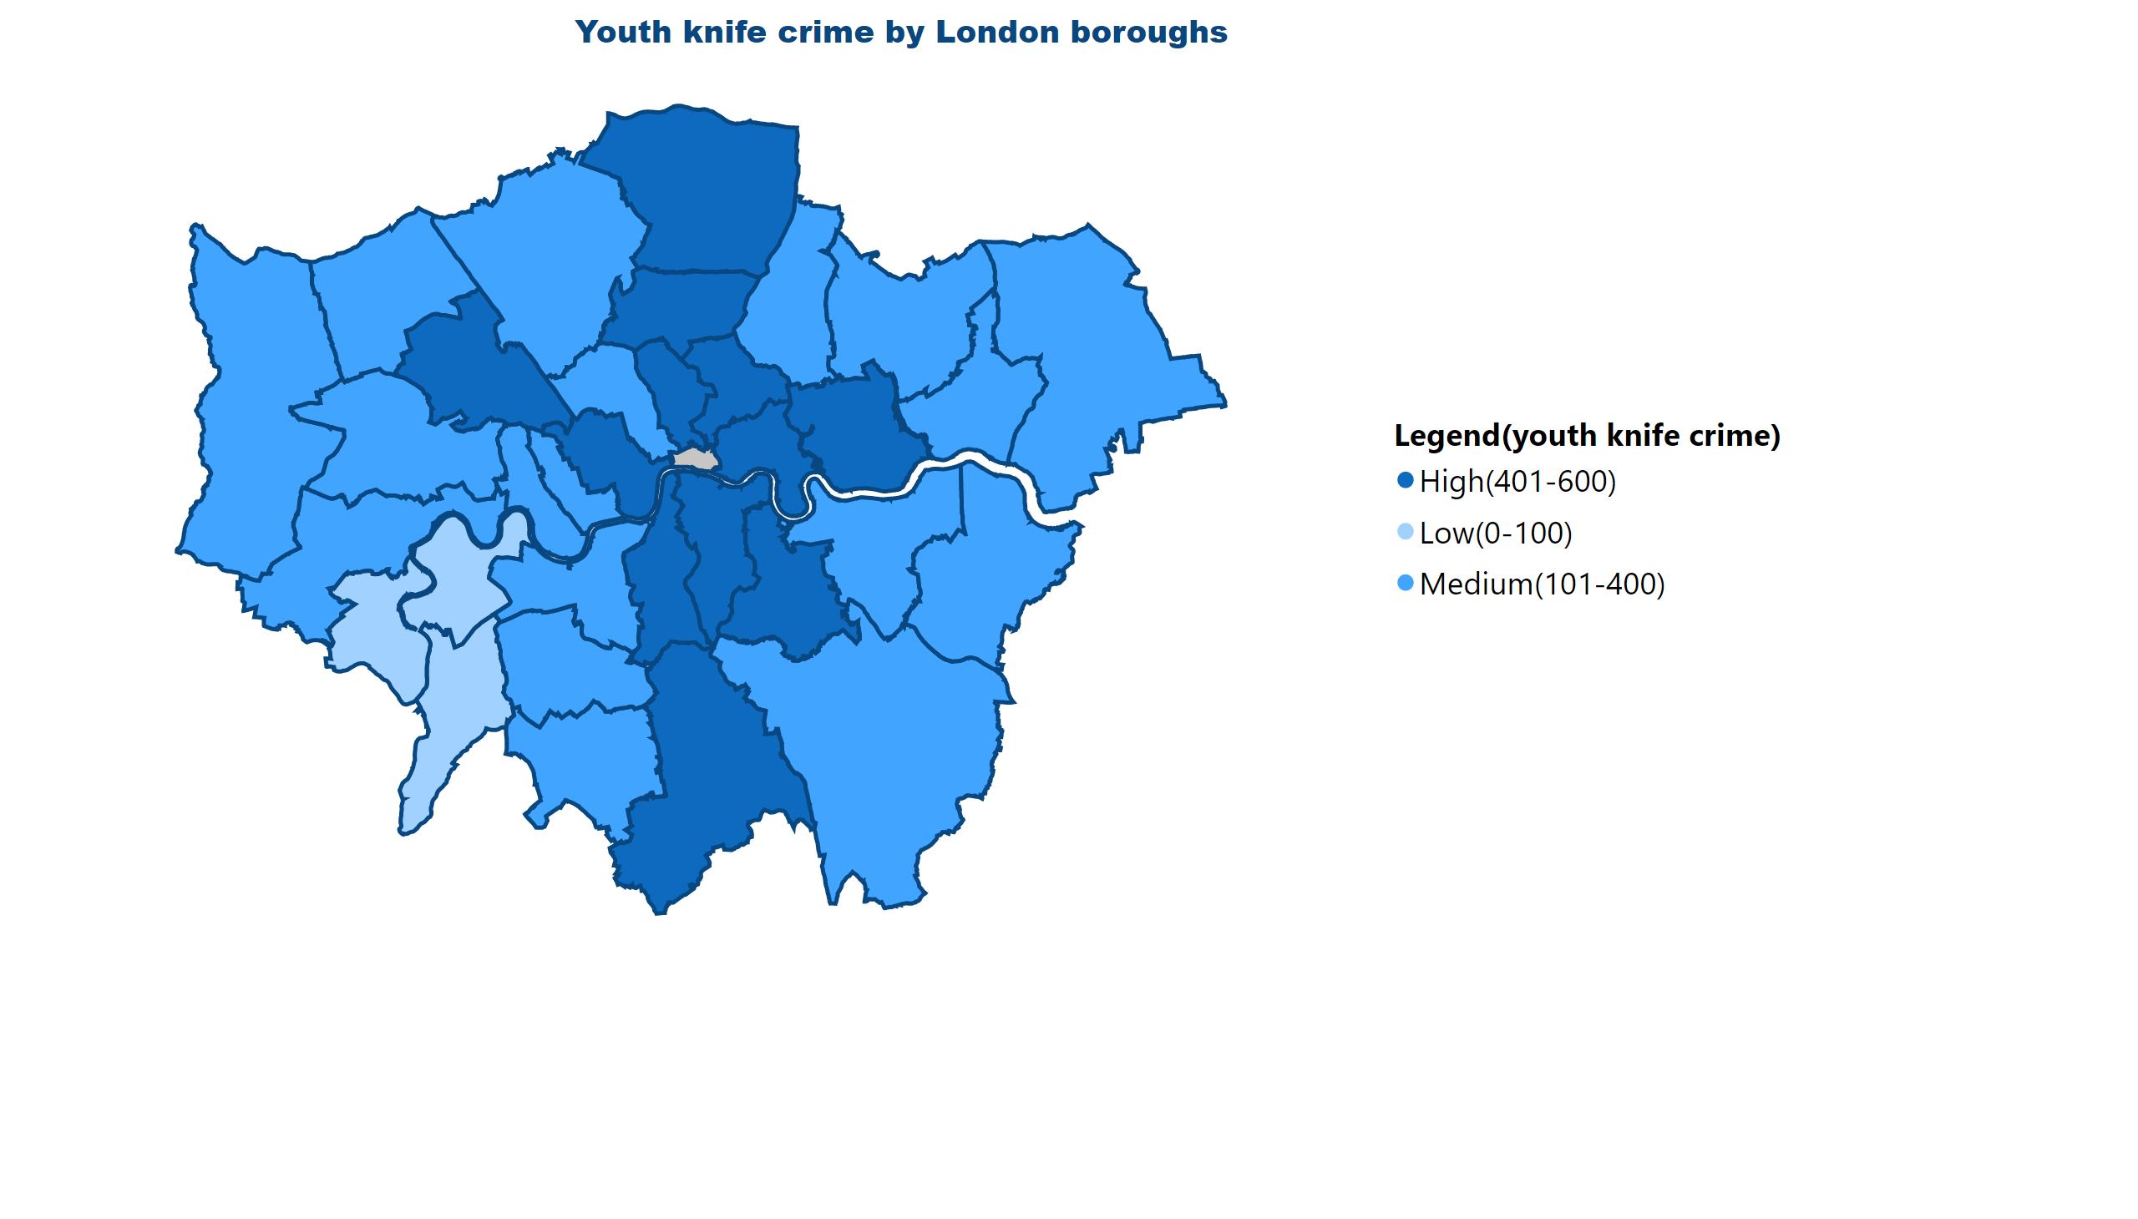
knife crime
Notes:
Youth knife crime by London boroughs
No alt text provided

Slide 3
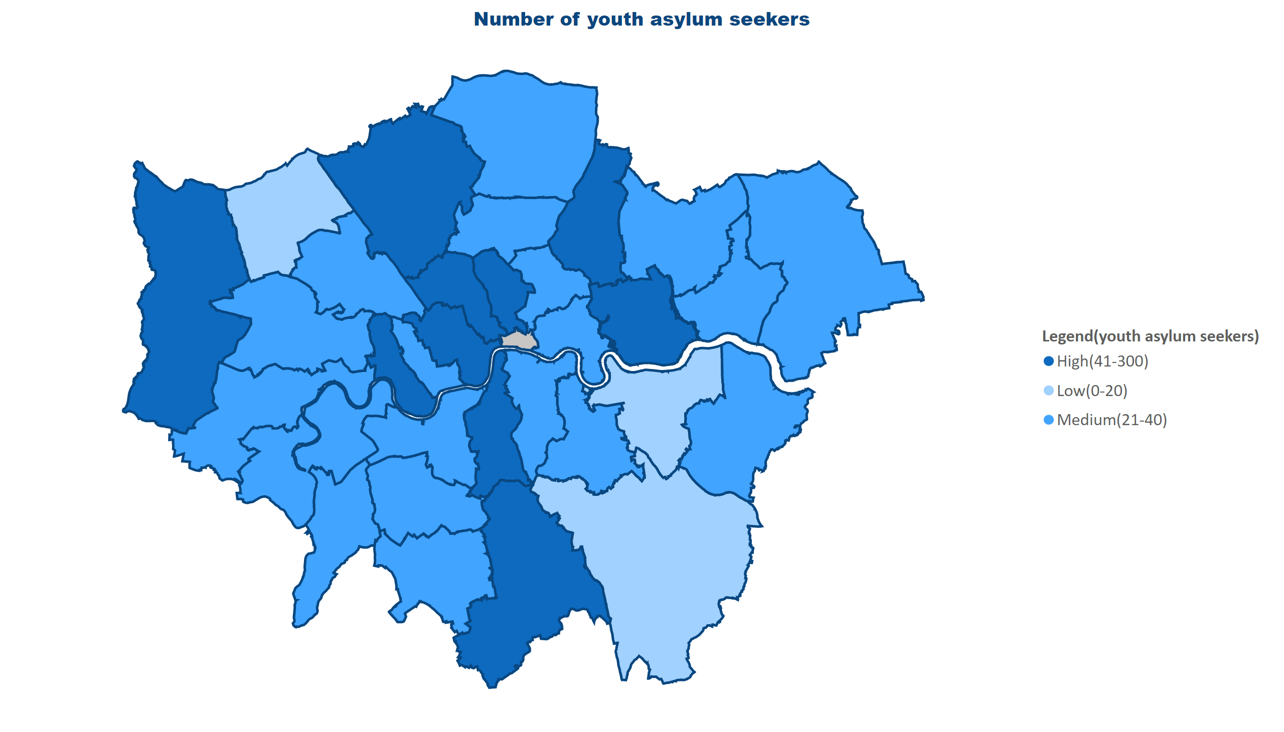
asylum seekers
Notes:
Number of youth asylum seekers
No alt text provided

Slide 4
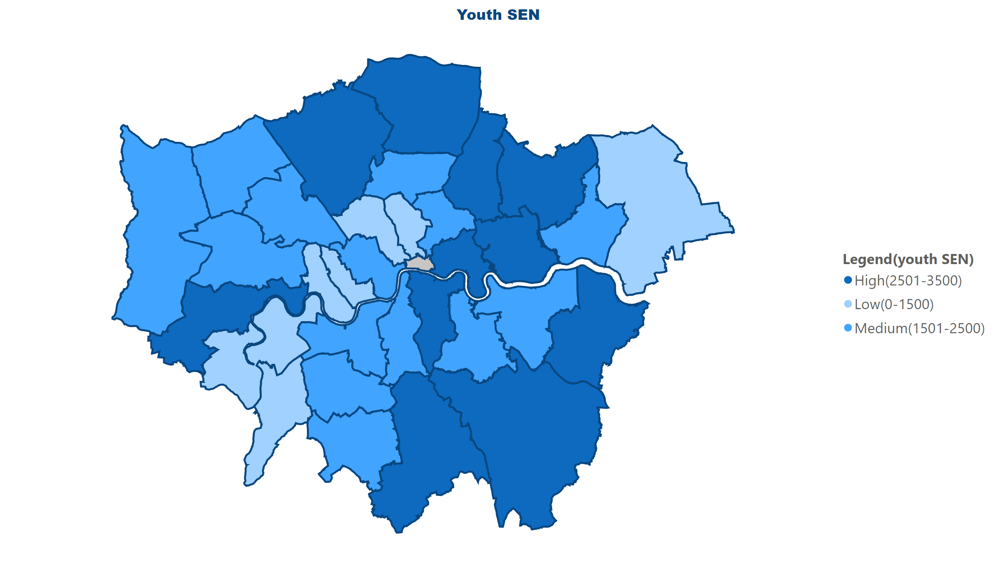
youth sen
Notes:
Youth SEN
No alt text provided

Slide 5
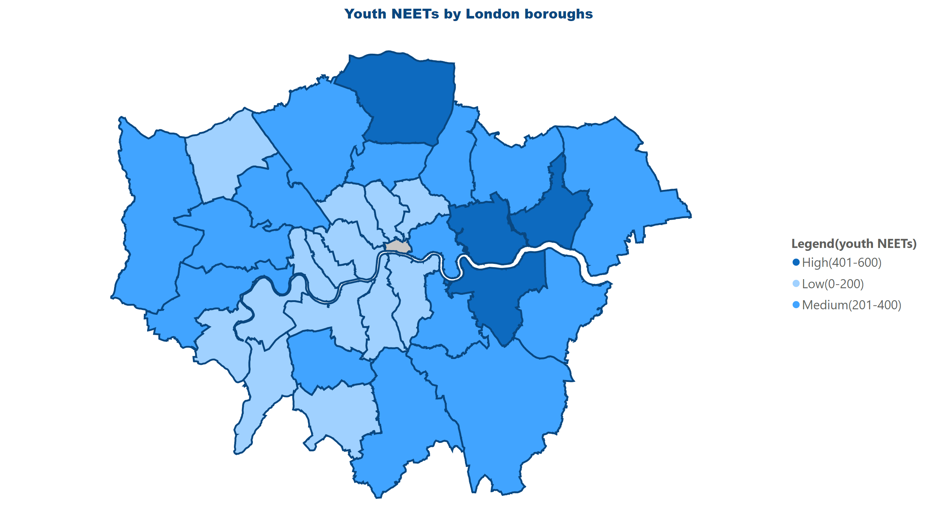
NEETs
Notes:
Youth NEETs by London boroughs
No alt text provided

Slide 6
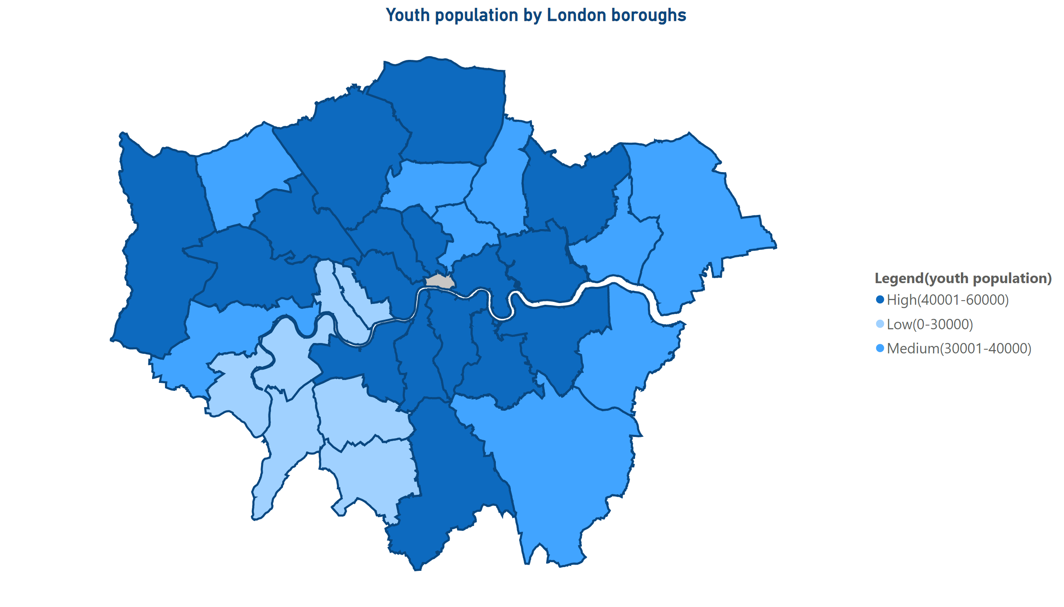
population
Notes:
Youth population by London boroughs
No alt text provided

Slide 7
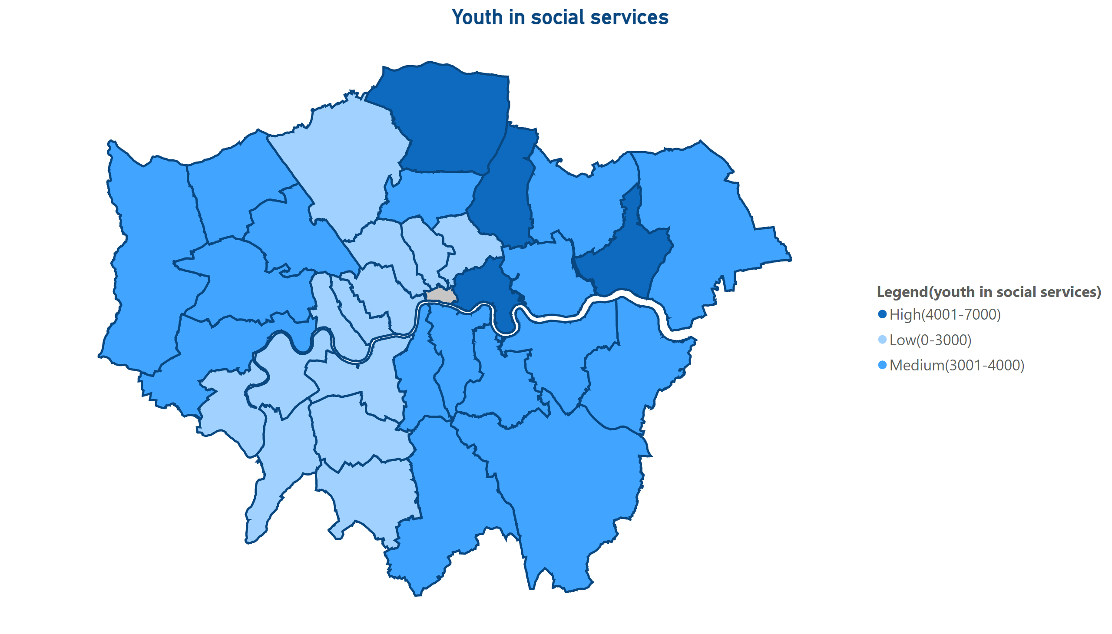
social services
Notes:
Youth in social services
No alt text provided

Slide 8
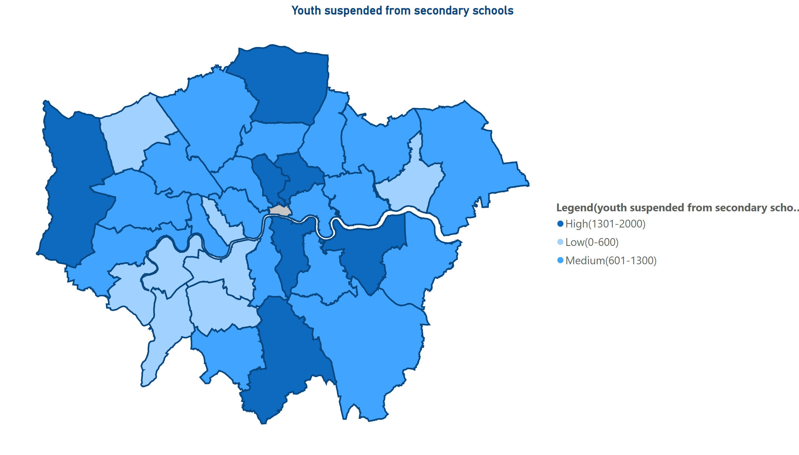
youth suspension from secondary schools
Notes:
Youth suspended from secondary schools
No alt text provided

Slide 9
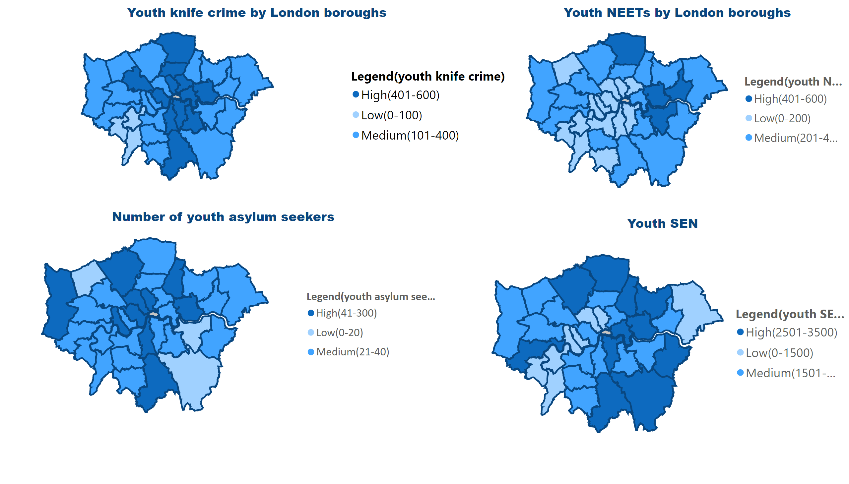
Youth engagement 1
Notes:
Youth knife crime by London boroughs
No alt text provided
Number of youth asylum seekers
No alt text provided
Youth SEN
No alt text provided
Youth NEETs by London boroughs
No alt text provided

Slide 10
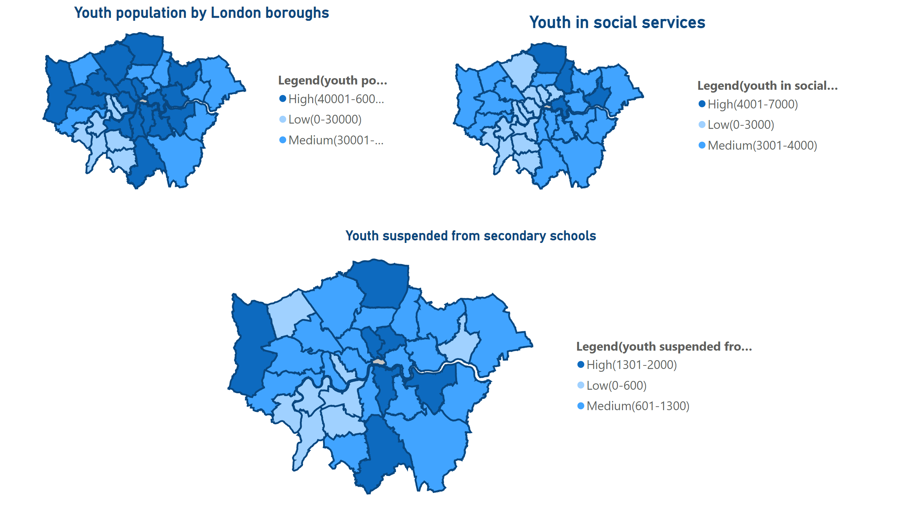
youth engagement 2
Notes:
shapeMap
No alt text provided
Youth population by London boroughs
No alt text provided
Youth in social services
No alt text provided
Youth suspended from secondary schools
No alt text provided

